Slide 1
Presenter notes
Resources:
Docs: Actions
Docs: Events that trigger workflows
Docs: Workflow syntax for GitHub Actions
Docs: Using encrypted secrets
Other workshop content on building workflows
GitHub Actions available for use (official list)
GitHub Actions toolkit
GitHub Marketplace: Actions
Example: Stale
Example: JavaScript Action
Starter workflows
Docs: Starting with pre-configured workflow templates
Blog: GitHub Actions Advent Calendar
Action toolkit: debugging
VS Code: Action extension
Troubleshooting: nektos/act
Demo prep:
No formal demo included
(Optional) Show some examples of Actions
FAQ:
FAQ slides included per smaller topic
Customer stories:
Expected timing:

Slide 2
GitHub Actions
GitHub Bootcamp
@presenter name (optional)

Slide 3
This module will enable you to:
Describe the advantages, components, and functionality of GitHub Actions
Identify GitHub Action types
Identify tools to troubleshoot an action
Identify best practices when writing an action

Slide 4

Agenda
Introduction to GitHub Actions
Components of an action
Action types & Marketplace
Examples
Troubleshooting & best practices
Notes:
On the topic of GitHub Actions:
You’ll find out what GitHub Actions are as a product as we provide you with an introduction.
Next, you’ll become familiar with the different components of a GitHub Action.
We’ll cover repository secrets.
Then, find out what self-hosted runners are.
You’ll be given an a glance at the GitHub Actions API.
Then, we will cover how you can post your action to the GitHub marketplace.
Please feel free at anytime pose questions.
********
Resources
https://help.github.com/en/articles/events-that-trigger-workflows The possible list of events is awesome. So much more powerful than Azure Pipelines
https://crontab.guru/
https://github.com/actions/runner
https://github.com/nektos/act
Resource: https://docs.github.com/en/actions/migrating-to-github-actions/migrating-from-azure-pipelines-to-github-actions makes it a little bit easier to migrate from ADO to Actions
********

Slide 5
Introduction to GitHub Actions

Slide 6

Actions Advantages
Fully integrated with GitHub
Respond to any GitHub event
Community-powered workflows
Any platform, any language, any cloud
Notes:
Advantages of GitHub Actions are:
Fully integrated into GitHub—from the merge box to the checks tab, from the UI to the API…
Trigger a job on any GitHub event, to automate any workflow in your team
Community is at the heart of GitHub. Anything you build with GitHub Actions is shareable, because it’s just code in a repo, you can make it public, fork it, edit it, and make it yours - dotcom and ghes (via GitHub Connect).
And finally, it has to work on any platform, any language, any cloud
Because Actions is built-in, there's no need to manually configure or setup CI/CD, to setup webhooks, to buy your own VMs, patch them and keep them up to date, monitor it, or do cost management, or shut down idle VMs. You just drop a workflow file in your repo, and you're up and running.

Slide 7
Key functionalities
Linux, macOS, Windows, and containers
Matrix builds
Streaming, searchable, linkable logs
Built-in secret store
Easy to write, easy to share
Notes:
Key functionalities of GitHub Actions include:
Run an Action in a container, or in a virtual machine, with hosted runners for Linux, macOS and Windows. (Free on public repos on GitHub.com, so you can run deployments and builds without worrying about setting up hardware. Self hosted runners are an option for those who do want or need to set up their own hardware.)
Actions also supports matrix builds, so you can run parallel jobs across OS versions, runtime versions, or any variable you want to use to multiply your workflows. E.g if you wanted to deploy 3 different versions of Node.
Actions gives you real-time feedback with streaming logs that are searchable and deep-linkable, so you can share a link to a specific line of a log with a friend to get help debugging a build.
To help integrate with third-party services or deployment targets, every repo on GitHub has a built-in secret store, and Actions will substitute secrets for your tokens. Encrypted tokens or private keys.
And finally, because it’s GitHub, Actions are easy to write, and easy to share. Built on the YAML syntax.
This is core to how software development works today.

Slide 8
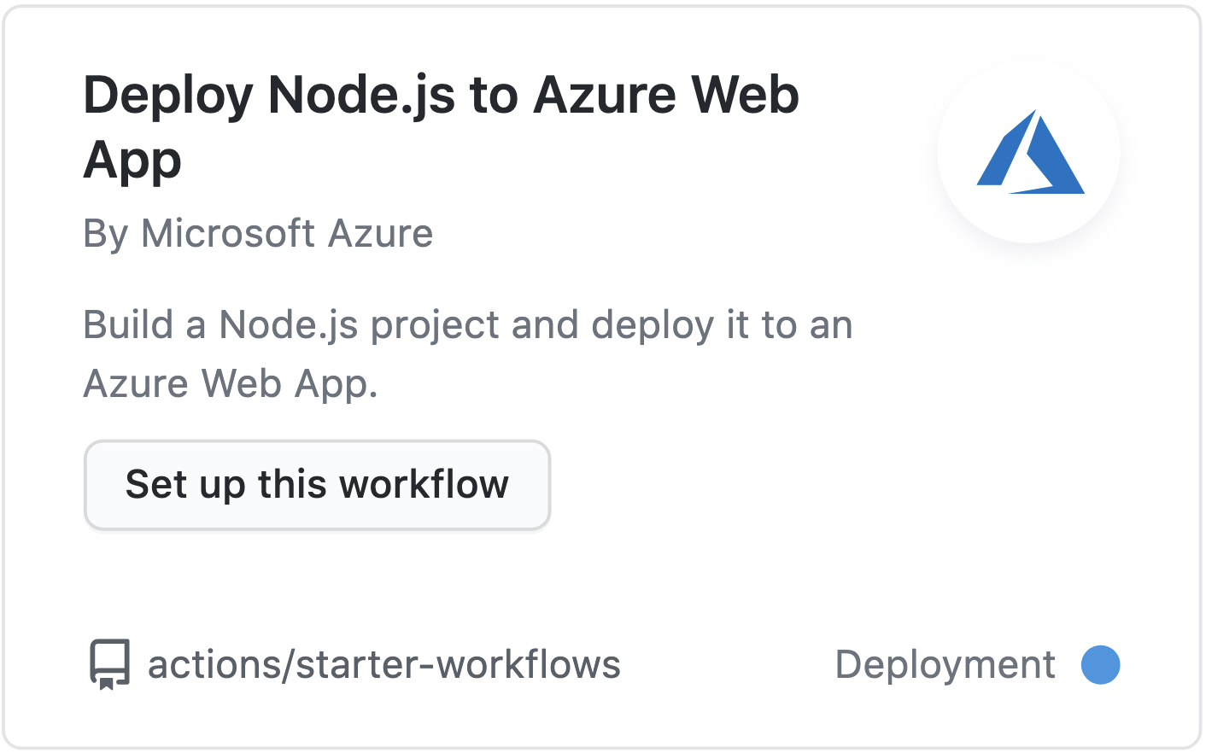
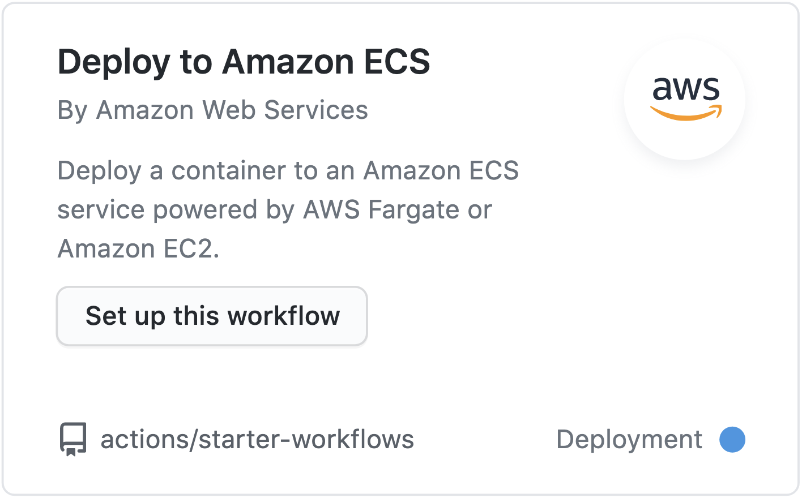
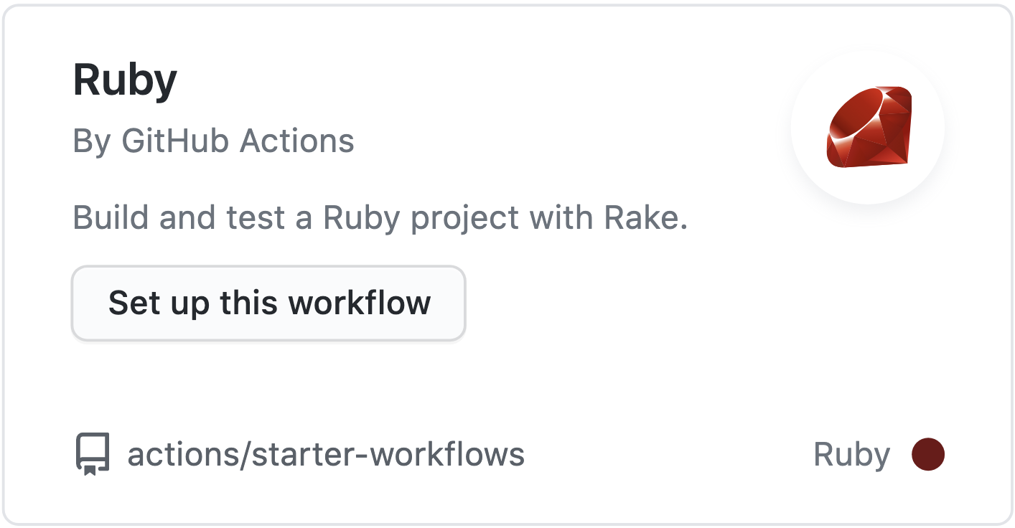
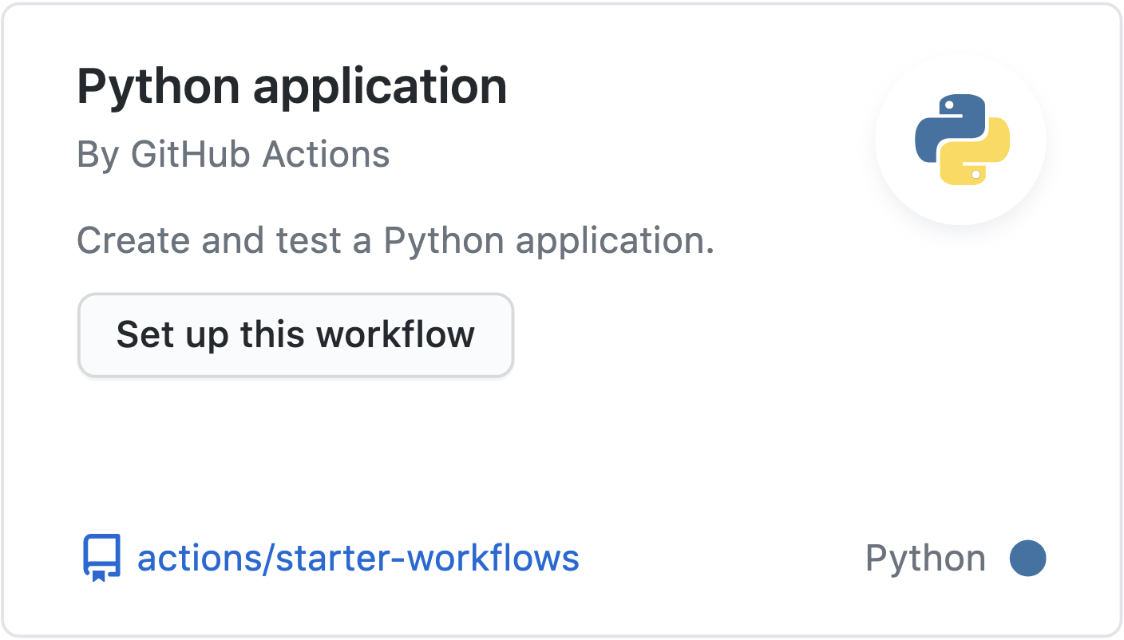
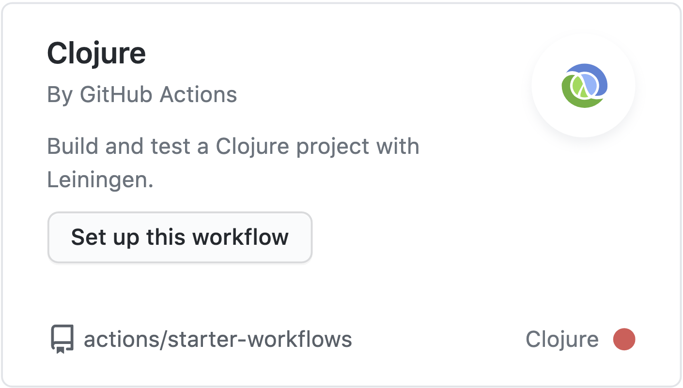
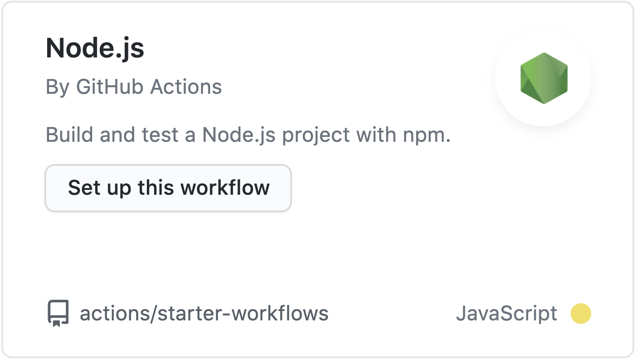
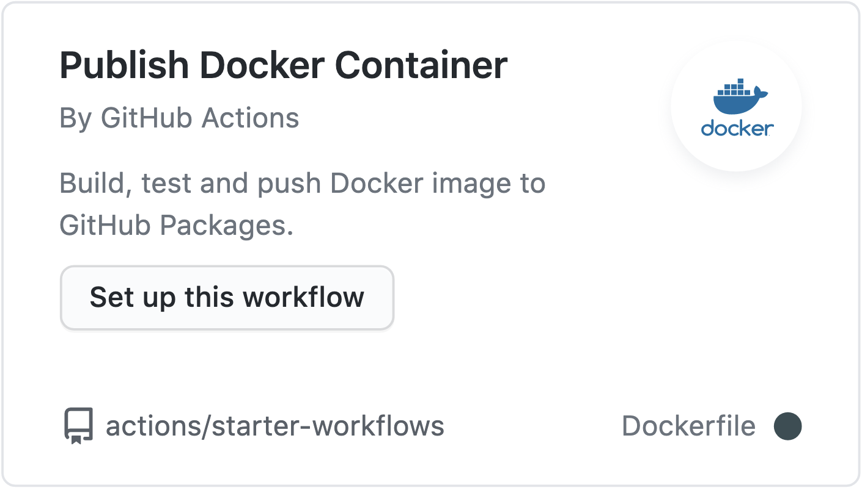
Automate workflows
(and many more)
Notes:
Deploy to any cloud
Millions of open source libraries
Interact with the any public APIs
Deploy to any cloud, create tickets in Jira, publish a package to npm, and more
Use the millions of open source libraries available on GitHub to create your own actions.
Write Actions in JavaScript or create a container Action—both can interact with the full GitHub API & any other public API.
Actions are used to automate any workflow.
It could be workflows for Onboarding teams, creating new repos and setting branch protections, creating releases, etc.
Teams have custom workflows that enable them to bring standard methodology and practices to software development.
Usually this involves integrating with other tools such as JIRA, or a Package manager. A lot of customers use JIRA.
GitHub Actions connects all of your tools to automate every step of your development workflow. Easily deploy to any cloud, create tickets in Jira, or publish a package to npm.
Want to venture off the beaten path? Use the millions of open source libraries available on GitHub to create your own actions. Write them in JavaScript or create a container Action—both can interact with the full GitHub API and any other public API
The most common workflow is CI/CD, but administrative tasks such as labeling can also be automated
Workflow possibilities:
It goes FAR beyond just ci/cd and check in. Complete workflows from welcoming and maintaining issues to everything else
You can have a central repo with reusable actions and workflow so you don't have to start over every time

Slide 9
Components of an Action

Slide 10
GitHub Actions
Events
Trigger
Workflows
Use
Actions
Notes:
GitHub actions are a way of automating your workflows. They are triggered on any event on GitHub.
There are 3 main parts that constitute GitHub Actions:
Events
Workflows
Actions
********
Resources
Actions documentation: https://docs.github.com/en/actions
********

Slide 11
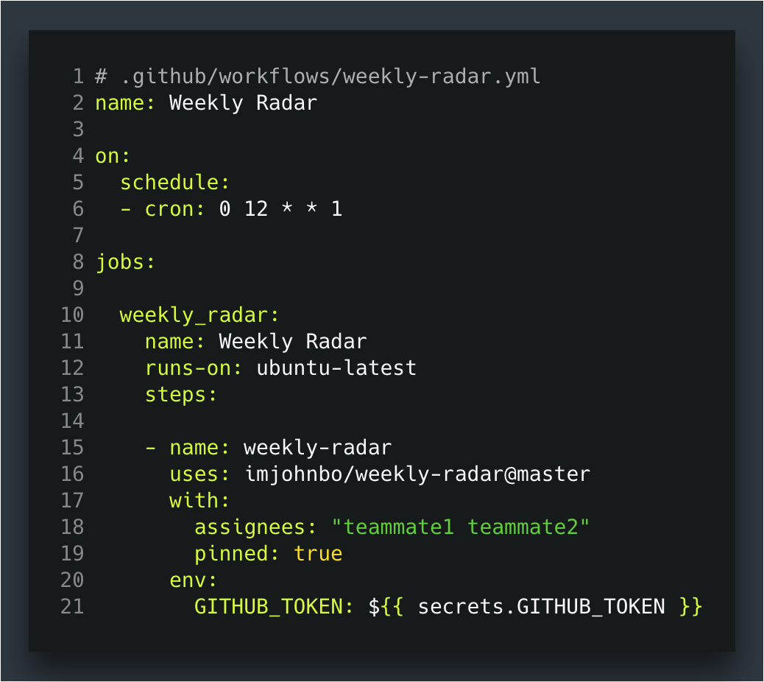
Events
GitHub triggered events: push, pull_request, public
Scheduled events: schedule
Manually triggered: workflow_dispatch (external systems)
Events
Trigger
Workflows
Use
Actions
Notes:
Before we dive into workflow files in more detail, let's talk about Events.
Events set GitHub Actions in motion. They are used to trigger a workflow.
Webhook events
A few examples are events in GitHub that could trigger a workflow are:
Opening an issue
Creating a branch
Creating a new pull request
Adding a new member to an organization
Chron schedule
A webhook is fired off when one of these events takes place and a workflow is triggered.
Schedule
Some teams use weekly issues for team updates, meeting notes, or status check-ins. Cron jobs can open these issues from templates automatically AND check to close them automatically if they're still open, so that when people wake up to their notifications on Monday morning, they see a notification and an already-opened issue with the context they need to get started.
This can be expanded with other automation to really fit the needs, like including aggregated data about how many issues are open in the backlog, or other project tracking mechanisms.
Repository dispatch
The repository dispatch event can be triggered by external systems. You can make an API call where you pass anything you'd like into a body parameter. It could be a JSON object, it could just be a plain text string. That event will come through, and you can actually listen on repository dispatch events and then parse out the information within that dispatch that you sent.
For example, if you're running something like Jenkins or self hosted runners, you may have a web interface that will allow people to fire off their builds automatically. You can set it up so a click of a button sends a payload to GitHub, which creates this dispatch event, which will fire off the action.
******************************
Resources:
https://docs.github.com/en/actions/reference/events-that-trigger-workflows
******************************

Slide 12
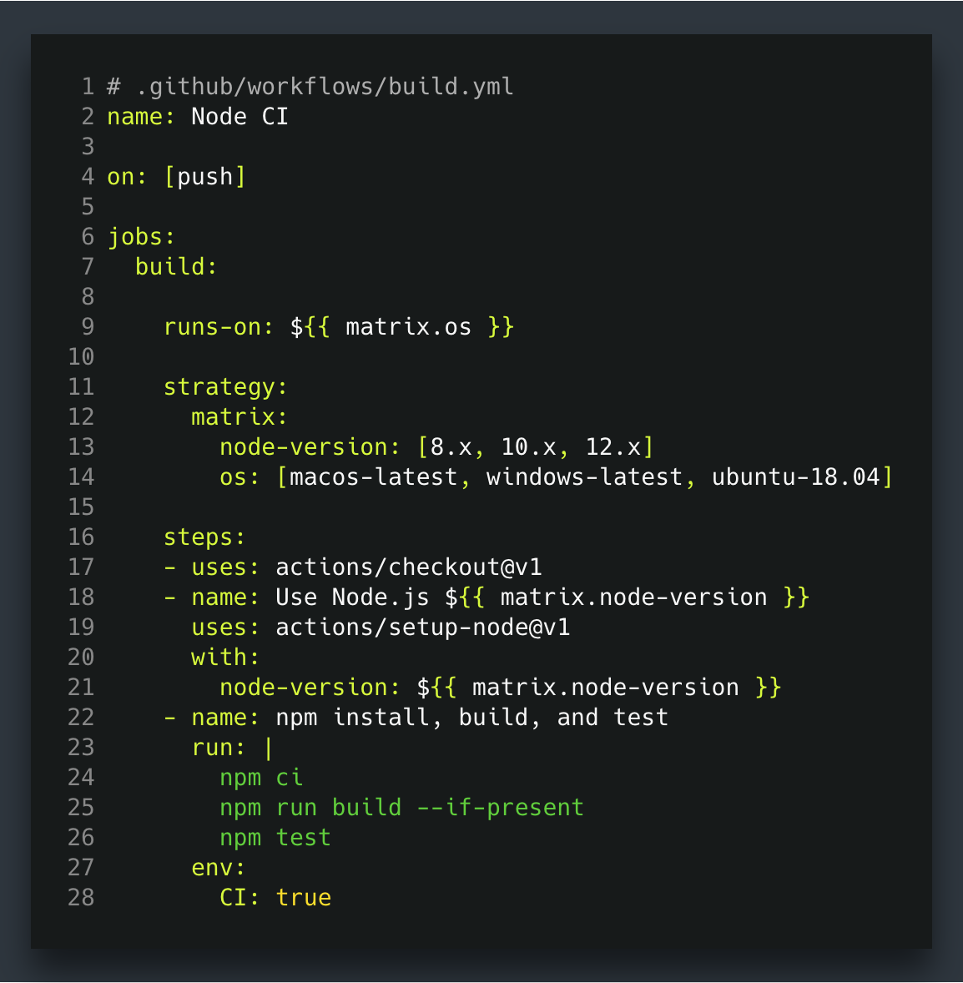
Workflows
Workflows are like pipelines
Codify useful, customized processes
.yaml syntax
.github/workflows
Events
Trigger
Workflows
Use
Actions
Notes:
Workflows are what the end user consumes; these are your pipeline, comparable to a Jenkins or a Travis file. A workflow is a collection of steps and jobs that are run.
Workflows let you codify useful, customized processes.
Workflows can solve several problems for various use cases. They can be used to solve issues that are:
Organizational: Such as creating a mechanism to welcome new contributors to a repository, or opening a new onboarding issue or project board automatically.
Legal - To ensuring license and policy uniformity – like watching for branch protection, and if branch protection is removed, an Action could be triggered to re-enable it right away
Application-related - Use them to test across multiple operating systems
Our focus today will be on CI/CD, but these other use cases are extremely valuable and can go a long way in operationalizing and automating processes across your organization.
Workflows belong in YAML files in a special directory in your repository, .github/workflows.

Slide 13
Workflows
Workflow files glue together existing actions in sequence
Listen for particular events
Then run pre-existing actions
Or shell scripts
Events
Trigger
Workflows
Use
Actions
Notes:
Events: Already discussed
Actions: We will talk about this in more detail soon; existing actions that are pre-written and modular
Scripts: When an Action is too heavy, scripting is an option
Discuss the workflow file, what each section means
********
Resources
https://docs.github.com/en/actions/reference/workflow-syntax-for-github-actions
********

Slide 14
Workflows
Actions run in VMs (Linux, Win, Mac)
Or Docker on Linux VM
Logs streaming & artifacts
Secret store with each repository or organization
Events
Trigger
Workflows
Use
Actions
Notes:
Workflows
Ability to specify environment
Can also have conditionals
Secret store, encrypted
********
Resources
Docs – using encrypted secrets: https://docs.github.com/en/actions/reference/encrypted-secrets#using-encrypted-secrets-in-a-workflow
Other workshop content on building workflows: https://github.com/githubuniverseworkshops/building-blocks#workflows
********

Slide 15
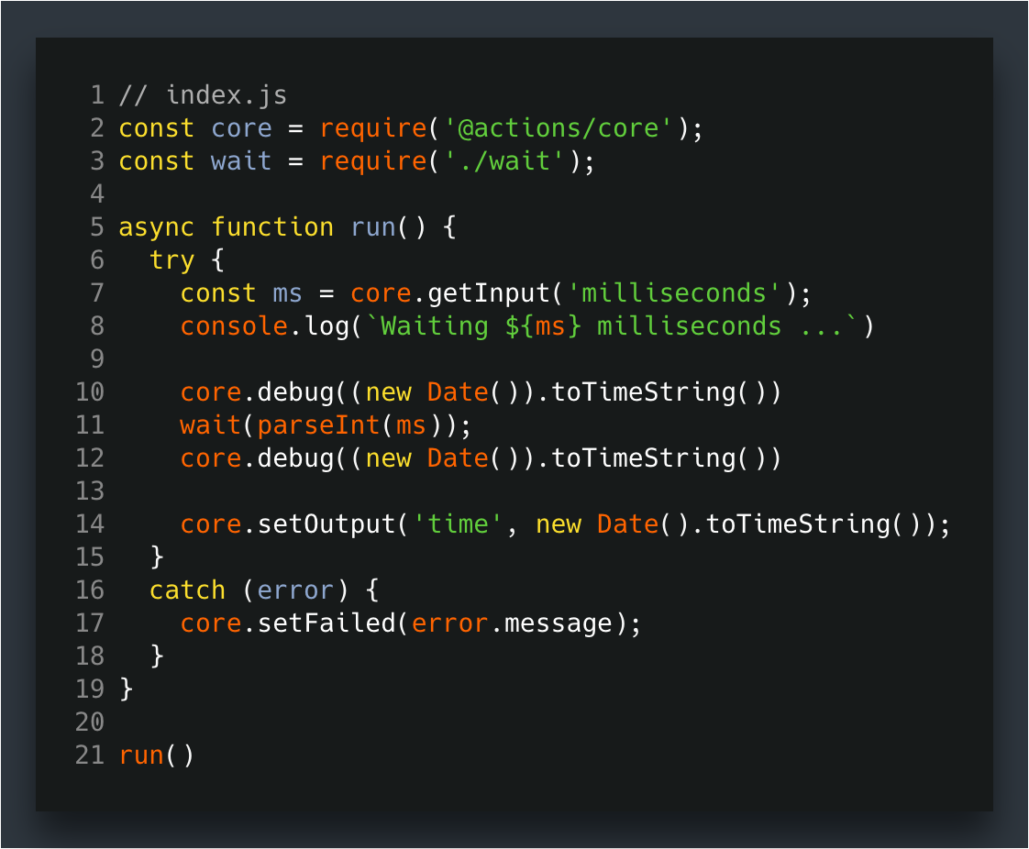
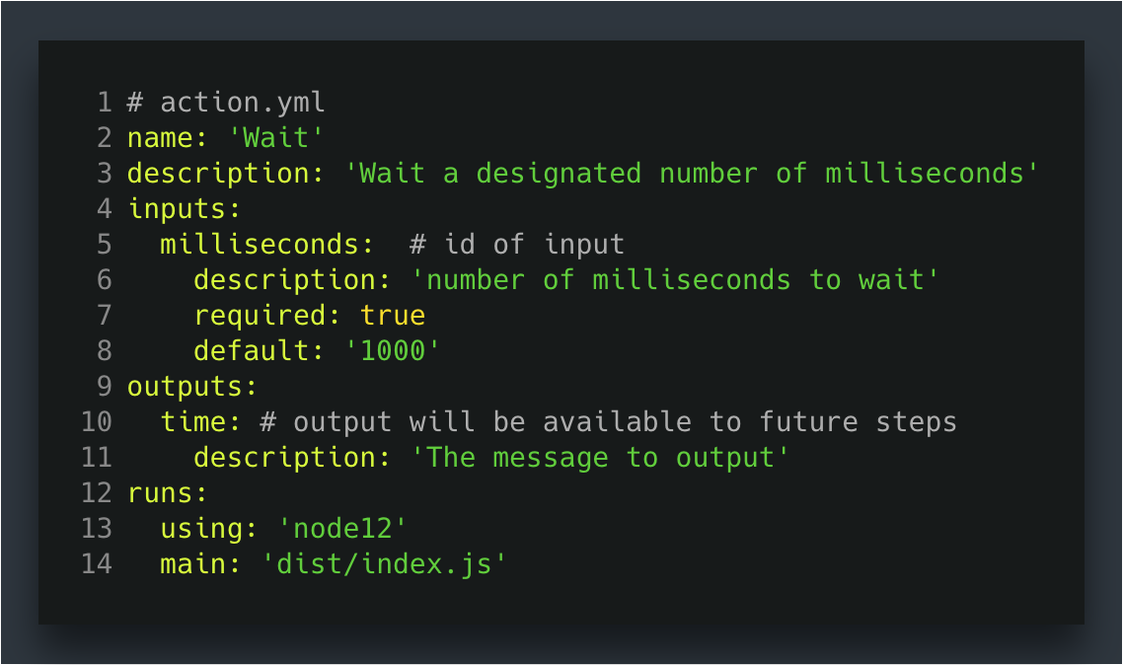
Actions
Reusable units of code
Referencing vs authoring Actions
Administrative features
Storing shared Actions
Post your actions to the GitHub Marketplace
Events
Trigger
Workflows
Use
Actions
Notes:
Actions are reusable units of code made available to your workflows. The steps or jobs within a workflow are called actions. Actions are where the actual automation executes.
So, we can say that workflows use actions.
Referencing Actions
GitHub runs them in a Node.js runtime or in Docker containers and are referenced from workflows as uses: owner/repo@ref.
Official list: https://github/actions
Authoring Actions
Components to Actions, when authoring:
action.yml; similar to a package.json file – defines inputs, outputs, environment.
index.js; main file for action entry point – includes code for Action.
We'll discuss scripting vs containers shortly
Administrative features
Setting Actions policies on the enterprise, organization, or repository-level
E.g. just enable verified Actions, or restrict to only using local actions
Storing shared Actions
Yes, Actions can live in repositories with other code. But why? They’re not particularly usable in that case.
But if you really want to do it, use something like .github/actions/my_action_with_other_stuff
Marketplace
We will talk more about this shortly.
********
Resources
Official list: https://github/actions
********

Slide 16
Action types & Marketplace

Slide 17
Types of Actions
Write in the language and environment that makes sense for you.
 | JavaScript action | Container action
Virtual environment | Linux, MacOS, Windows | Linux
Language | Anything that compiles to JavaScript | Any
Speed | ++ | +
User experience | ++ | +
Notes:
There are 2 kinds of actions:
A JavaScript action (Node 12)
A container action
Considerations
The screen shows a chart with the important points to remember.
JavaScript
May use the GitHub Actions Toolkit for command line argument parsing, passing parameters, interacting with the GitHub API
For anything that compiles to JavaScript, you can run it as a JavaScript action
It will just run natively on the VM, whether it's Linux, Mac, or Windows.
Because of that, you also get a little bit faster speed execution becausee the system runs the environments already preloaded with all the software that you need.
JavaScript actions are faster, runtime is more versatile, and offer a better user experience.
Container Actions
If needs to compile, can be run in a container. (Docker)
Similar to beta 1 actions, but with updated syntax & argument passing
Or point to existing actions published to Docker Hub
If you wanted to write an action in a language such as Go, C sharp or something that doesn't compile back to JavaScript, that's where you need to put the action into a container.
The containers only run on Linux at this time
********
Resources
GitHub Actions toolkit: https://github.com/actions/toolkit/blob/master/README.md#packages
********

Slide 18
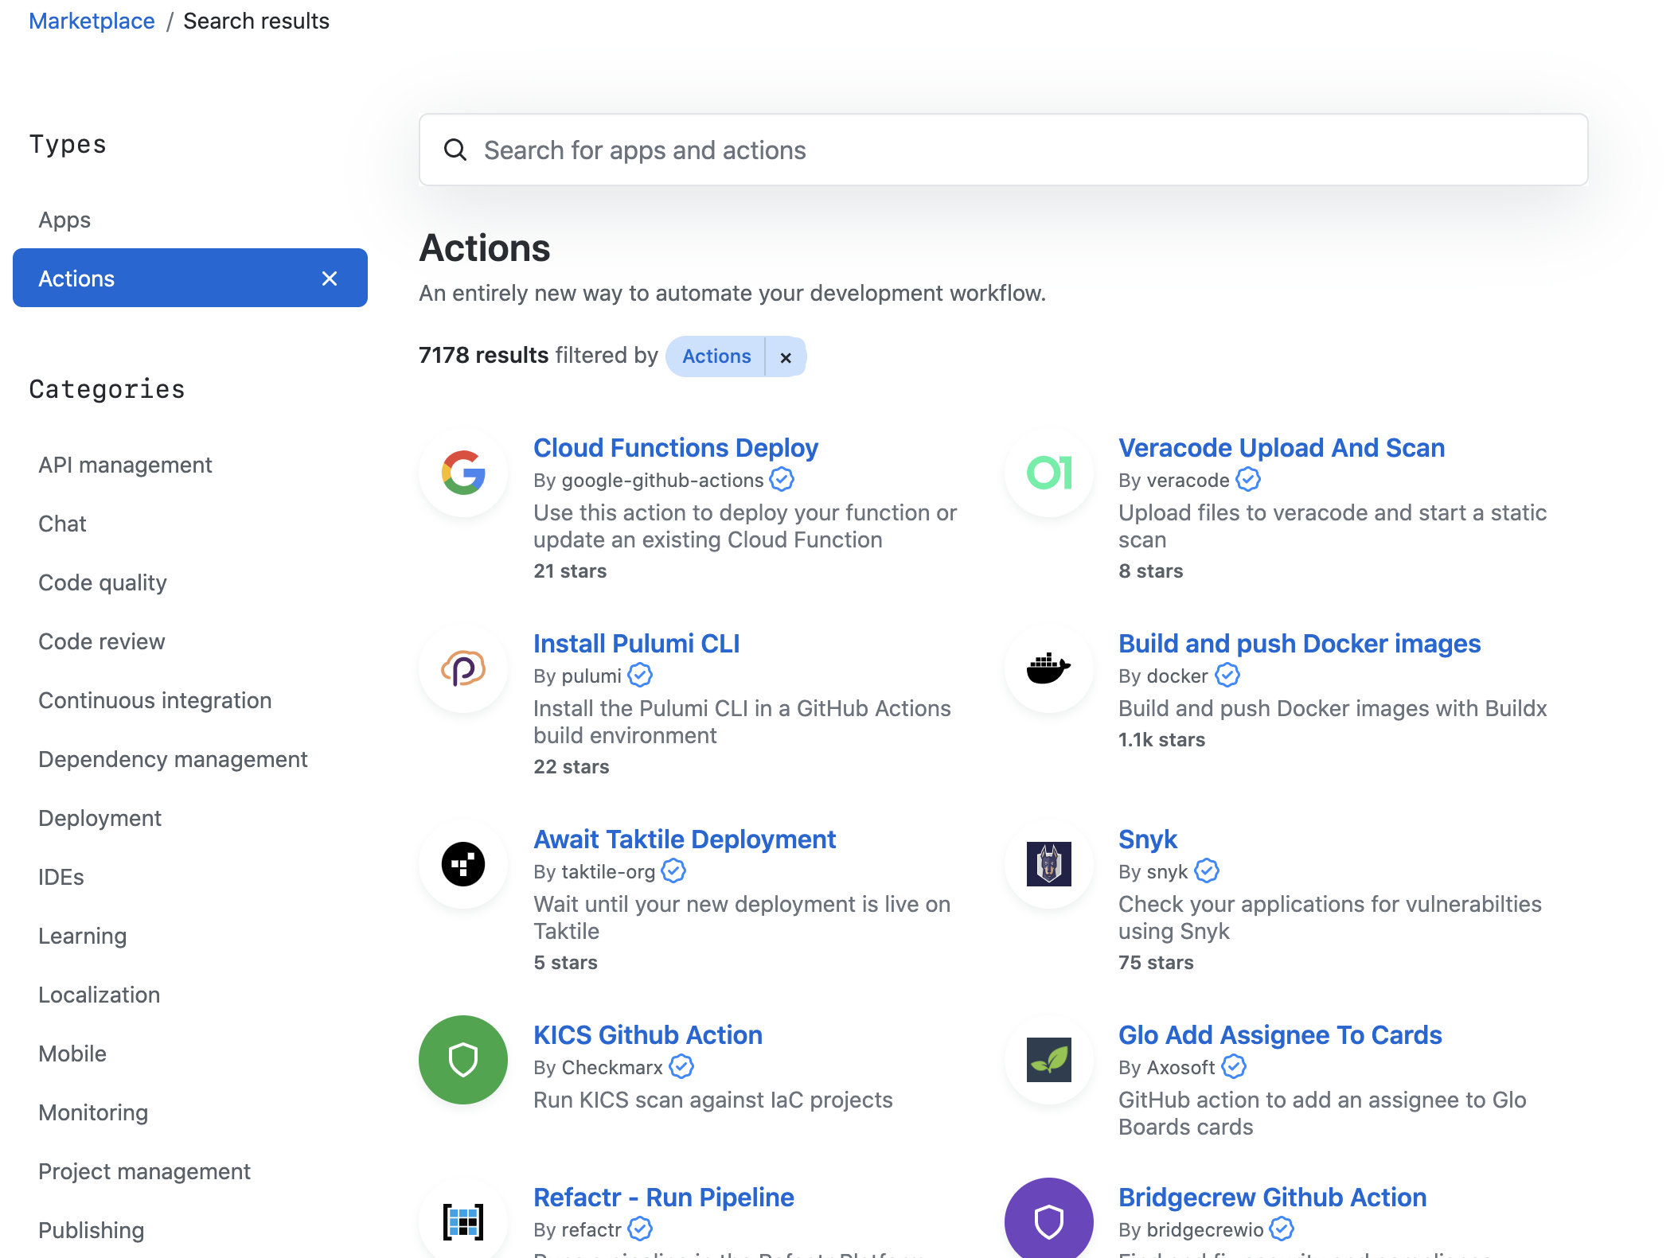
GitHub Marketplace
https://github.com/marketplace?type=actions
Notes:
The GitHub Marketplace is a central hub from which you can download actions that have been certified for many categories.
A lot of Actions do similar things, but for customers it might be relevant whether an Action is maintained by an individual contributor vs official Actions e.g. from Atlassian
This can be controlled in the enterprise/org/repo settings
*******
Resources
https://github.com/marketplace?type=actions
********

Slide 19
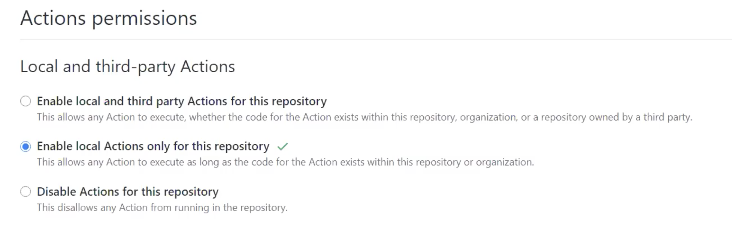
Administrating actions
Notes:
As an administrator, there are options for what Actions you will allow to run.

Slide 20
Questions
Notes:
********************
Note to presenter:
The questions below are for your reference only. They are ones that you can anticipate receiving from the audience. However, there is no need to pose these to your audience.
********************
Q: Can we check who used our github actions?
A: https://docs.github.com/en/free-pro-team@latest/developers/github-marketplace/viewing-metrics-for-your-listing
Q: How do we get our published actions as verified creator?
A: To submit something to marketplace as a verified developer, you can submit an app for review. You can see the requirements here.
https://docs.github.com/en/developers/github-marketplace/submitting-your-listing-for-publication
https://docs.github.com/en/free-pro-team@latest/developers/github-marketplace/requirements-for-listing-an-app
https://github.blog/changelog/2021-02-11-listing-applications-on-github-marketplace-got-simpler/, https://github.blog/2021-02-04-github-reduces-marketplace-transaction-fees-revamps-technology-partner-program/, and https://docs.github.com/en/developers/github-marketplace/applying-for-publisher-verification-for-your-organization
Q: How can we find out if there is a newer version available for an action?
A: Manual checking is the only current method available. Set the 'uses' flag to point to the latest version inside of the action configuration
Q: Is there official security guidance around using actions from the marketplace? You are pulling in someone else's code that could potentially be doing something 'dangerous'
A: https://docs.github.com/en/free-pro-team@latest/github/setting-up-and-managing-your-enterprise/enforcing-github-actions-policies-in-your-enterprise-account

Slide 21
Examples

Slide 22
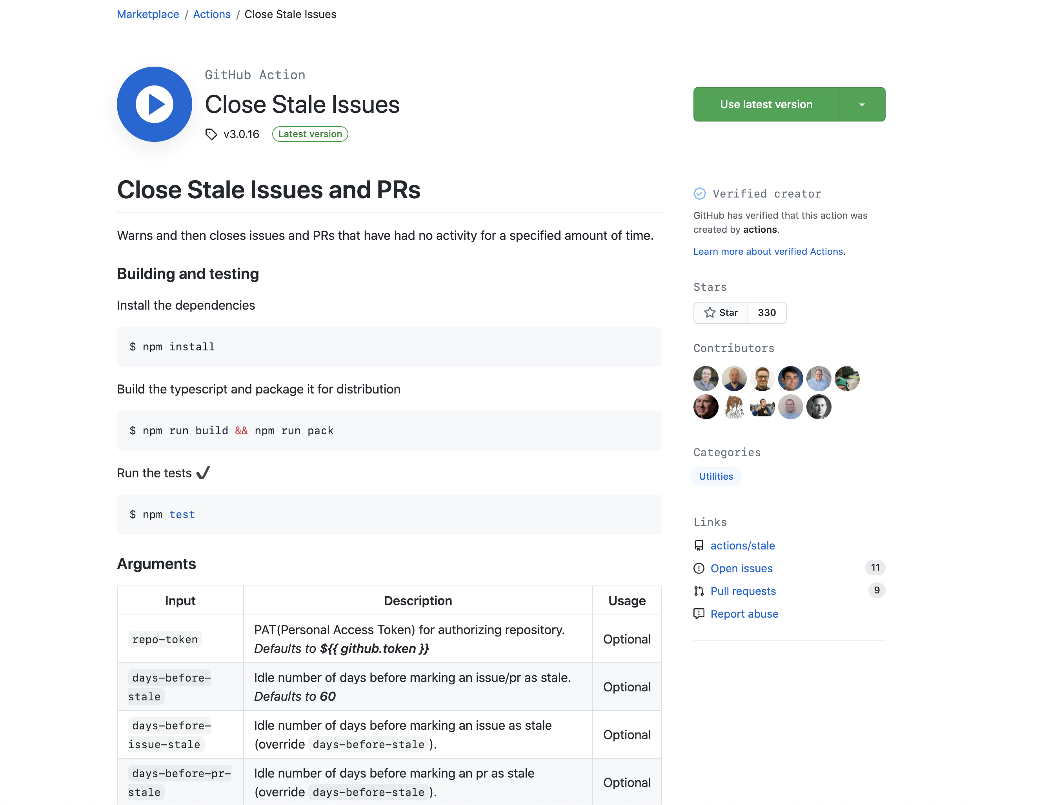
https://github.com/actions/stale
Notes:
Describe and link to the "Close Stale Issues" Action
********
Resources
Stale - https://github.com/actions/stale
*******

Slide 23
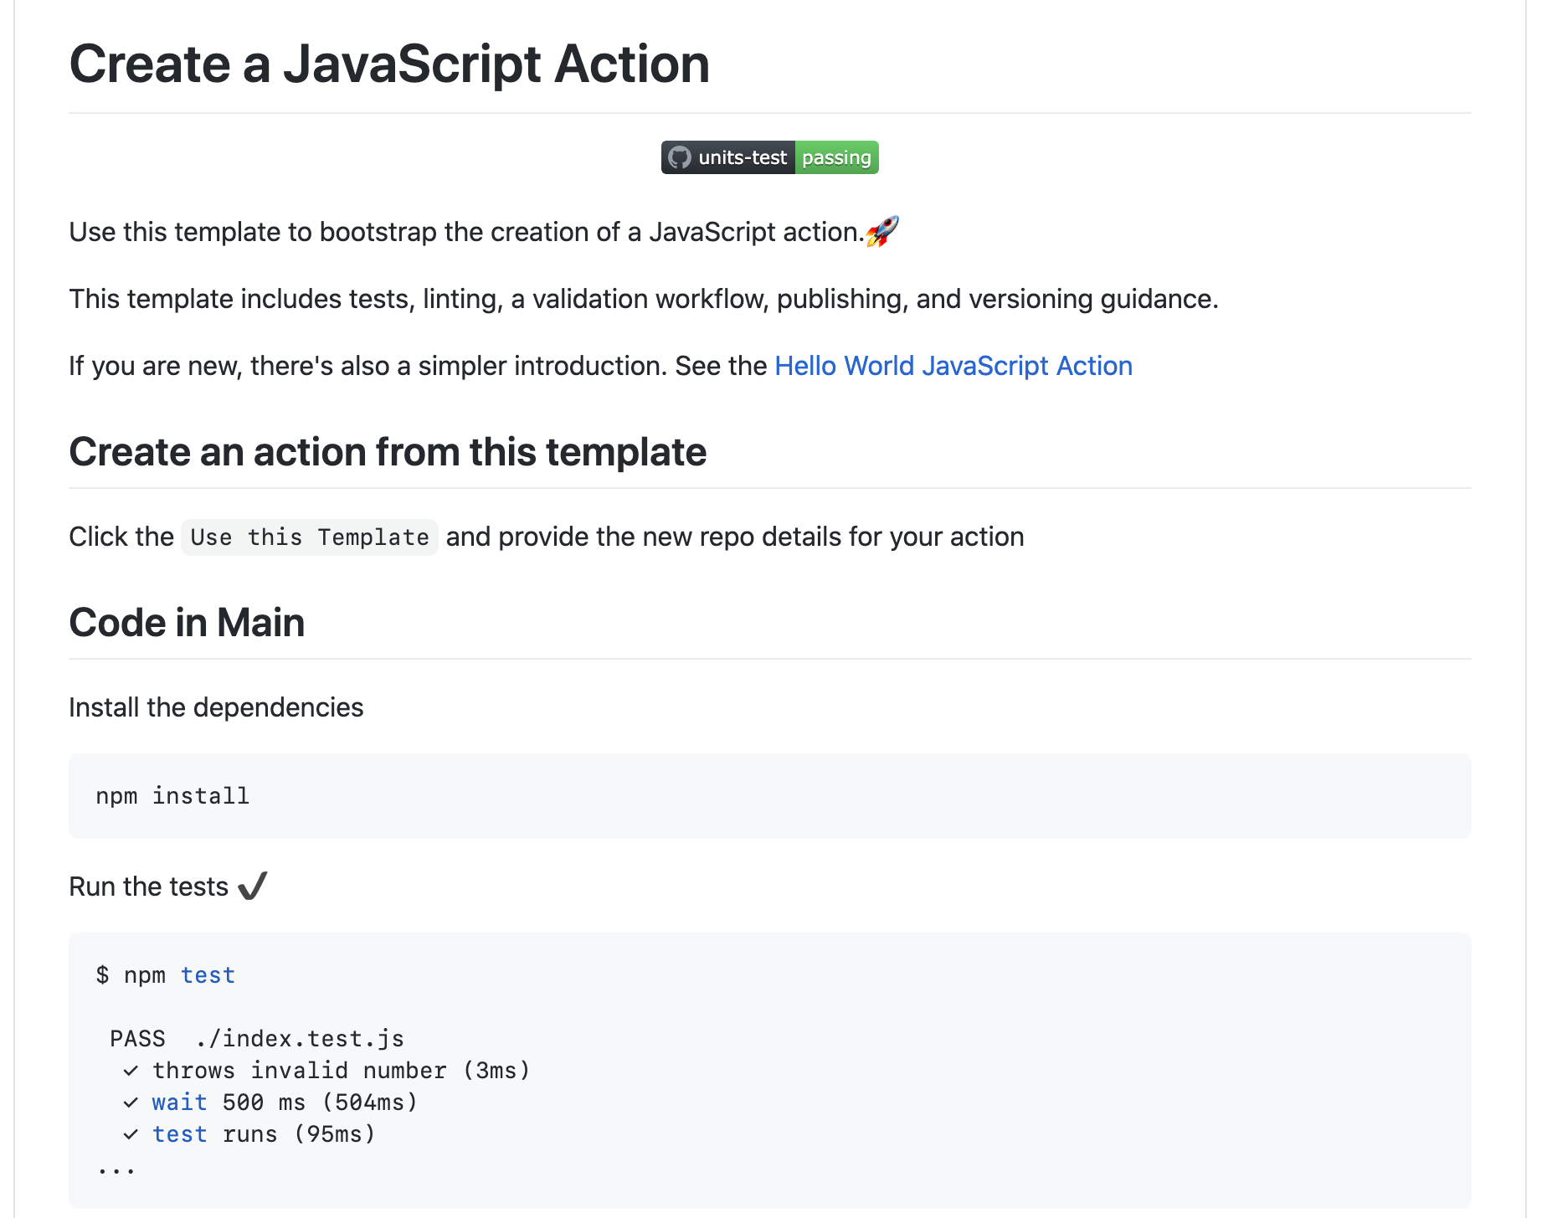
https://github.com/actions/javascript-action
Notes:
Describe and link to the javascript-action template
********
Resources
Javascript-action - https://github.com/actions/javascript-action
*******

Slide 24
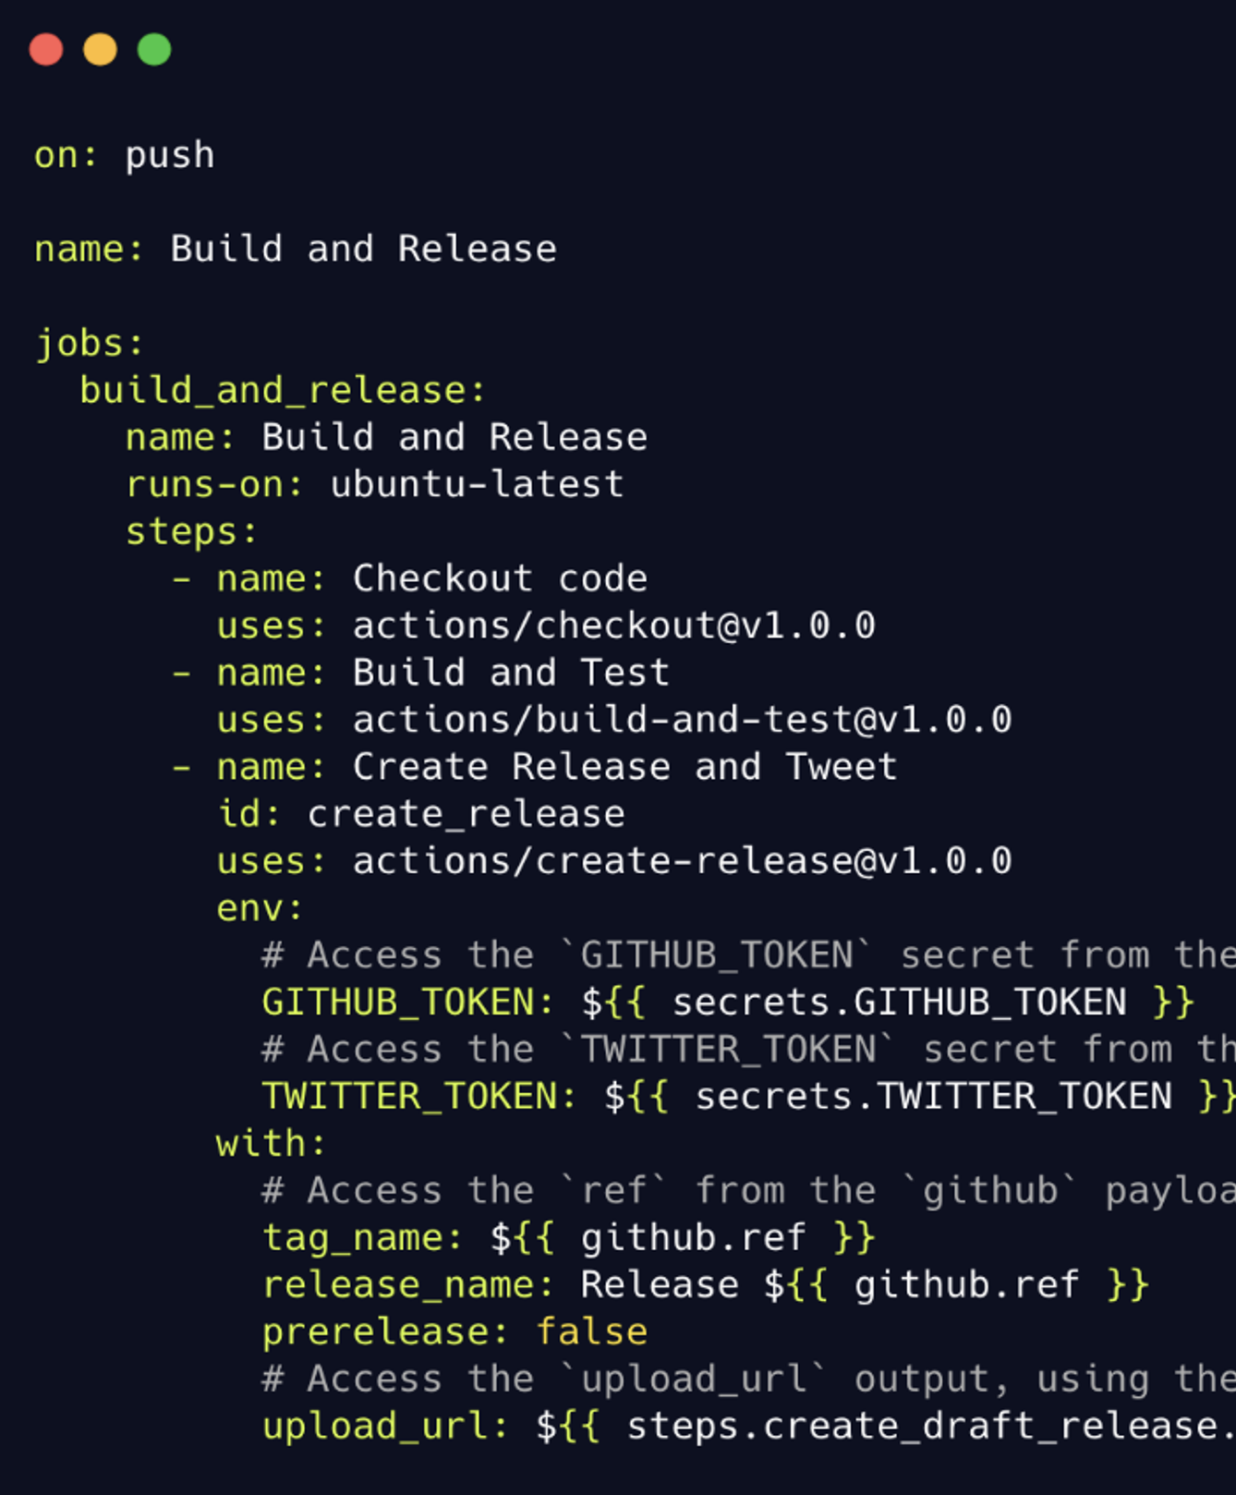
Monolithic action example
Check out the code
Build and test
Release
Notes:
The screen shows a sample workflow file in which the the user attempts to build and release some code. After the release is finished, they want to tweet out about it and notify their community that a new version of the product has been released.
Here is how the monolithic action is structured:
a first step of checking out code
next, there is a step called Build and Test that completely builds the project and then runs testing on it.
the next step releases the project.
We see a lot going on in one step. A lot of things happening and numerous inputs and information.
Now let’s compare the way this action is structured to a chainable action.

Slide 25
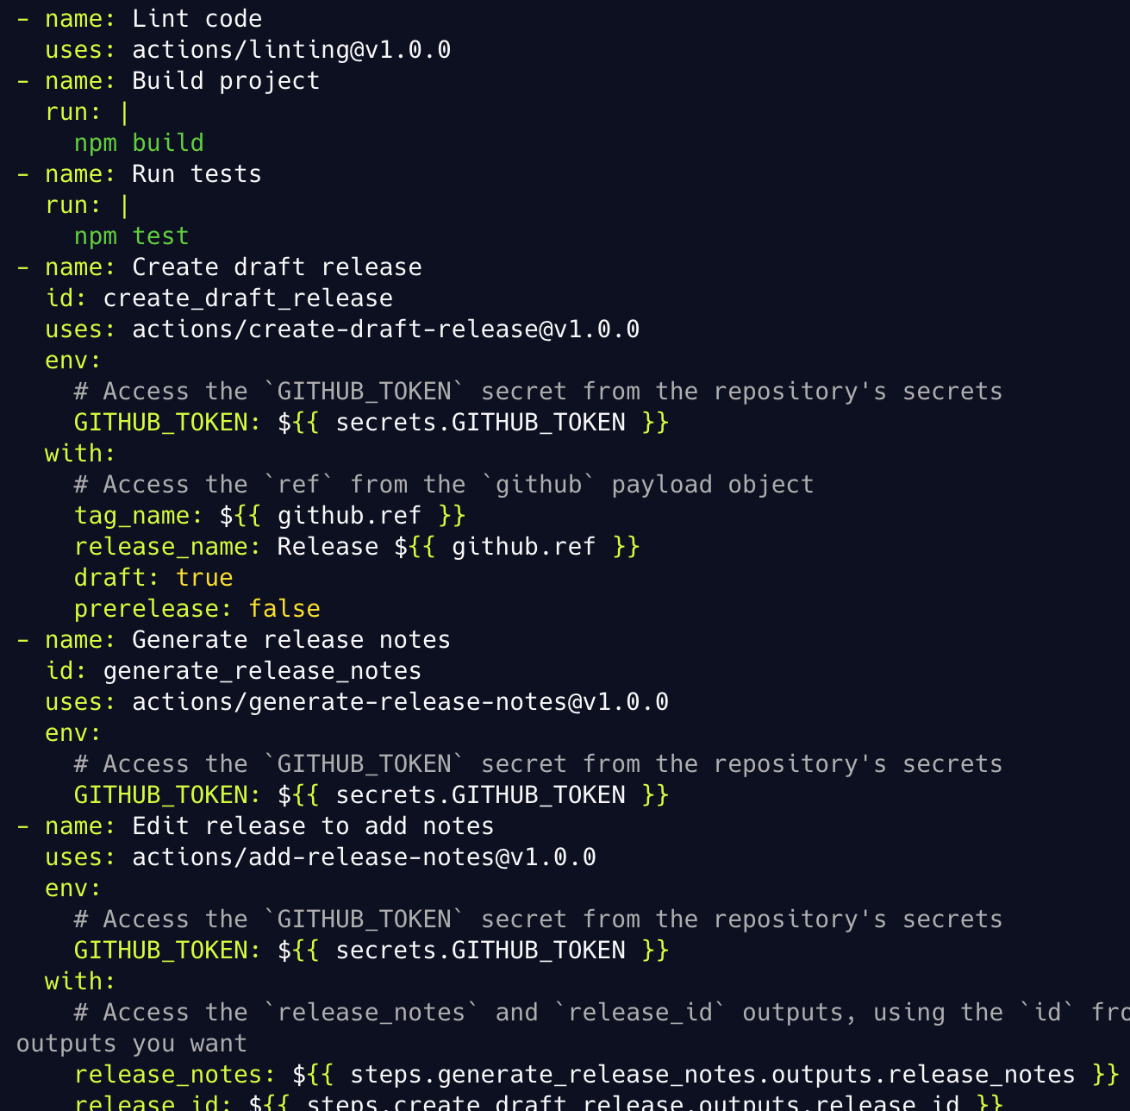
Chainable action example
Create draft release
Generate release notes
Edit release, add notes
Notes:
Notice on lines 1 and 2 of this code example how the action is structured by linking to another piece of code. Instead of having the inputs directly in the action, we import from another source. This provides flexibility.
The same sort of structure happens in the following steps:
create draft release
generate release notes
edit release and add notes
The downside of the monolithic action is that it is difficult to locate points of failure when the action does not run correctly. There are always logs to look into.

Slide 26
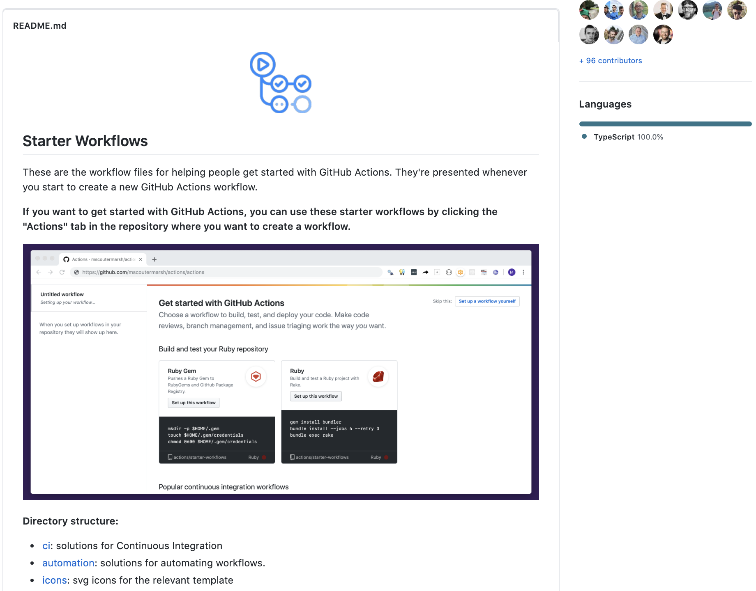
Starter workflows
GitHub provided starter workflows
Preconfigured for specific languages and frameworks
Suggested workflows based on language and framework
Create your own workflows
Notes:
Preconfigured for specific languages and frameworks
GitHub analyzes your code and suggests the workflows based on your language and framework
You can also choose from categories
For GHES 2.22.x: A number of Actions come pre-packaged with the release. Access to .com Actions via GitHub Connect.
The documentation for using starter workflow is provided
Use starter workflows to get started quickly. You can use from a set of pre-configured workflows to create a CI workflow or an automation workflow.
Examples of other starter workflows; JFrog Artifactory, Terraform, OpenShift CLI, iOS, AWS, Azure deployments, ...
If you do not have existing actions in your repo then you’ll be presented with a set of starter workflows when clicking the “Actions” tab. The list of suggestions is based on the code analysis of your repo.
For Enterprise Server 2.22 and above; a number of actions come pre-packaged together with the release
********
Resources
https://github.com/actions/starter-workflows
https://docs.github.com/en/actions/getting-started-with-github-actions/starting-with-preconfigured-workflow-templates
https://edwardthomson.com/blog/github_actions_advent_calendar.html
*******

Slide 27

DEMO

Slide 28
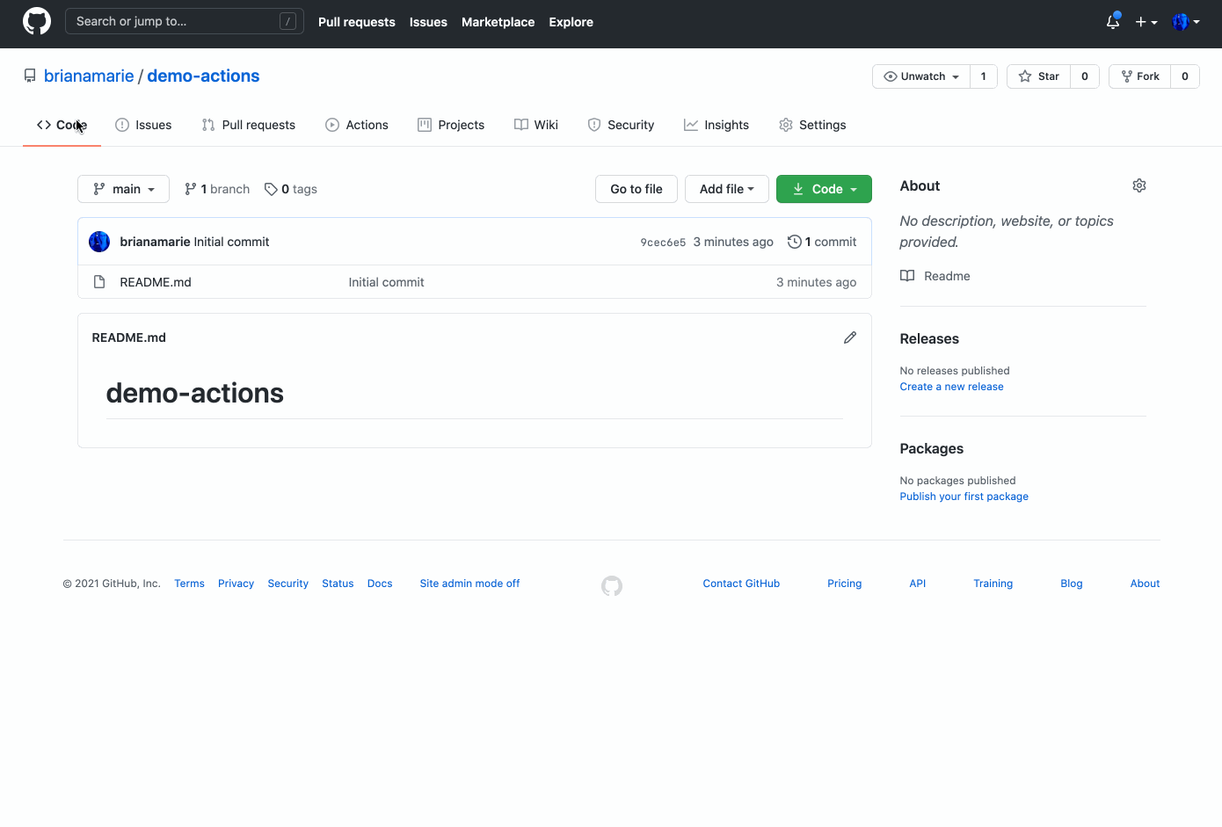
Starter workflows
Notes:
(Screenshot is a gif)
When you go to the Actions tab GitHub gives a list of workflows to get started and you can choose one by clicking the `set up this workflow` button

Slide 29
Troubleshooting & best practices

Slide 30
Troubleshooting tools
Workflow editor
Action-debugging
VS Code extension
nektos/act
Notes:
There are tools available to help troubleshoot while configuring or writing actions.
********
Resources
- https://github.com/actions/toolkit/blob/master/docs/action-debugging.md
- Have you tried writing your workflows on GitHub and not VS Code? There is a workflow editor that provides GitHub Actions specific autocomplete and linting! which helps validate the workflow file YAML before you commit
- Here is a VS Code extension that may be helpful with YAML stuff https://marketplace.visualstudio.com/items?itemName=me-dutour-mathieu.vscode-github-actions
- https://github.com/nektos/act
********

Slide 31
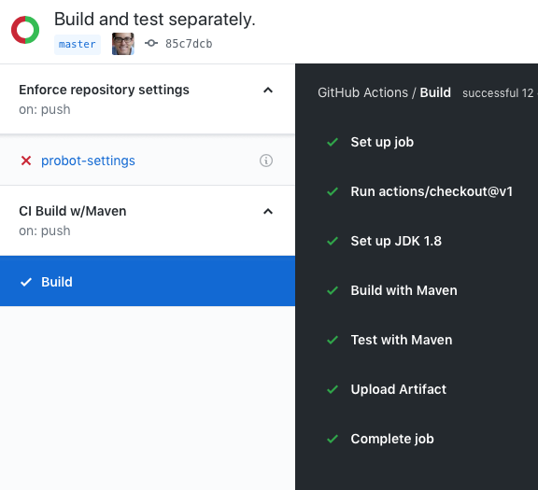
Workflow use
Events
Jobs
Steps
Logs
Notes:
Things to keep in mind:
Events kick off the workflow
Jobs run each in their own VM
In parallel (unless the workflow says otherwise)
Job specifies the VM Linux/Windows/MacOS
Steps run in the same VM
Share filesystem
Logs are searchable, link to individual lines
Artifacts can be saved
Can run jobs in parallel or in sequence `using` the needs option
Within jobs you have individual steps that run in sequence
Note: You can chain workflows using the workflow_run event

Slide 32
Best practices
Versioning
Documentation
Test coverage
Maintain metadata
Post to the marketplace
Notes:
What are some best practices when writing actions?
Write actions in a way that they can be used with others
Version your action.
Example: 1.0.0.
Include a version 1 tag that points to the first version
Use a “latest” tag pointing to the latest version
There are actions that can watch your action to increment version numbers automatically if you would like to use those
Good documentation. The better you document your action, the better of an experience users will have implementing it.
This applies both to open source and innersource. Within the company even, you want people to know who to contact with questions
A well written README will serve this purpose
Create unit tests. It is even possible to have actions to run these tests
Maintain your metadata. The metadata in your action.yml needs to be kept up to date. It will provide information such as
entry point of your action
the author
a description

Slide 33
Questions
Notes:
********************
Note to presenter:
The questions below are for your reference only. They are ones that you can anticipate receiving from the audience. However, there is no need to pose these to your audience.
********************
Q: Is there a default time out for actions?
A: https://docs.github.com/en/actions/getting-started-with-github-actions/about-github-actions#usage-limits talks about the various timeouts
Q: How do the on events for Actions work when you have a big mono repo? Can you filter on folders or something?
A: https://docs.github.com/en/actions/reference/workflow-syntax-for-github-actions#filter-pattern-cheat-sheet
Q: Can multiple actions run in parallel?
A: Yes
https://docs.github.com/en/actions/reference/workflow-syntax-for-github-actions#jobs
A workflow run is made up of one or more jobs. Jobs run in parallel by default. To run jobs sequentially, you can define dependencies on other jobs using the jobs.<job_id>.needs keyword.
workflows are also independent and will run in parallel if the even that you have multiple things that need to happen on the same event but aren’t necessarily related.
For example, we have multiple workflows execute when an issues event happens in our repo. One workflow checks for specific labels to add to triage, and the other checks for issue body content to update the out of office schedule.
Q: Can you split a workflow into multiple workflows that depend on each other?
A: You can have as many workflow files as you'd like. However, the caveat is that a workflow cannot trigger another workflow. So like if you had a workflow that, for example, created a release for you and then you had a different workflow that was listening for that release event to do something. We don't allow actions to trigger actions because we can get into this endless loop type thing. So what you can do instead if I go back to some syntax like this, you can see that I have this job called Building release. But I could have multiple jobs here and then I could tell it. There's a syntax option that says needs.
Q: How do approvals work? For example, moving from dev to staging to production and having somebody actually sign on off of it?
A: This is just code that lives in your repository. Of course we hope you have branch protection configured. With CODEOWNERS files, you can specify that if someone is making a change specifically to some file or directory, then certain individuals or certain team needs to review that code. This would fall under the same you know code review process that you would do normally. Additionally, this is something our product team is working on to make it more intuitive.
Q: Are there any limits for how many works for workflows we can trigger? What are the limits, and how it can be use it for our enterprises outside of typical use? (Ex: at conferences)
A: So if you're using the GitHub hosted runners, the limit is, I believe, four hours or four and a half hours that the VM can be running before it will terminate itself that's to prevent things like bitcoin mining and stuff like that, as best as we can. I believe our billing still says that it's completely free for public repositories.
Thomas Hughes: For public repos. And then if it's a private repository. That's where you run into like build minutes where you're going to be paying for portions based on how much your consumption is and all of that. If it's a private repo and on a paid account the workflow can run for up to 72 hours.
Ex: So, you know, in this case, my organization’s paid tier gives me 50,000 minutes included for private repos. I can see how much is being used across various operating systems and then I can actually set up the limit too. So I can say hey you know after this 50,000 I only want to spend $100 or whatever it is.
Similarly, a little bit further down, you get to see the storage as well. So this is for things like your packages and get a package registry and then also things like the actions artifacts from build artifacts and things like that.
There are billing tabs for the organization and enterprise levels that can supply usage reports.
********

